Slide 1

ProMedTS: A Self-Supervised, Prompt-Guided Multimodal Approach for Integrating Medical Text and Time Series
Presented by:
Sreehitha Korrapati

Slide 2
Authors and affiliations
Shuai Niu, Jing Ma, Hongzhan Lin, Yida Xu – Hong Kong Baptist University
Liang Bai – Shanxi University
Zhihua Wang – Shanghai Institute for Advanced Study of Zhejiang University
Wei Bi – Tencent AI Lab
Guo Li – Manchester Metropolitan University
Xian Yang* – The University of Manchester

Slide 3
Background/Motivation
Why This Research Matters?
EHR data includes both structured (labs, vitals, meds) and unstructured (clinical notes) information.
Most models focus on one type of data, missing cross-modal insights.
LLMs can understand text but not time-series data directly.
Integrating both can improve prediction of surgical complications and enhance clinical decision-making

Slide 4
Problem Statement
The Challenge in Multimodal Healthcare AI
Time-series data is irregular and incomplete.
Text and numeric data are not aligned.
Existing models lack transparency in decision-making.
Limited focus on specific outcomes like postoperative complications.
Research Question:
How can self-supervised prompt-guided learning be used to effectively integrate medical text (unstructured data) and physiological time-series data (structured data) to improve disease diagnosis performance across multimodal EHR datasets?
Notes:
Solution, methodology-> modular design,RL, prompt engineering, implementation,evaluation metrics,experiments,key findings, future work, implications,summary
Results as a graph would be better and what are the evaluation metrics for the loss functions in SSL, explain the components in the design of the frameworkand though the f1 score is better in some other baseline models-> they are either focusing on one kind of may be?

Slide 5
Related works
Multimodal Learning in Healthcare
Goal: Combine multiple EHR data types (text, labs, images).
Past Models:
  MedCLIP (Wang et al., 2022) — aligned medical images and reports using contrastive learning.
  RAIM (Qiao et al., 2019), GLoRIA (Huang et al., 2021) — combined text with numerical/image data using attention mechanisms.
  LDAM (Niu et al., 2021) — cross-attention with disease labels to fuse lab + note data.
  EHR-KnowGen (Niu et al., 2024a) — converted lab data to text and added external knowledge for fusion.
Notes:
Many prior works tried to mix different data types (like MedCLIP, RAIM, GLoRIA, LDAM).
Most combined images + text or lab tests + disease labels, but didn’t fully unify them into one representation.
These methods lacked fine-grained alignment across diverse data modalities.
“Earlier models could align images and text or fuse lab data with notes, but they lacked a truly unified space where all modalities interact seamlessly. This gap motivated the development of ProMedTS.

Slide 6
Healthcare with Large Language Models
LLMs (Large Language Models) have revolutionized reasoning and generation in medicine.
Past Models:
Clinical CoT (Kwon et al., 2024) → used chain-of-thought for diagnostic reasoning.
GatorTron, MedPalm, GPT4-Med → improved QA and reasoning via RLHF and CoT prompting.
Limitation: Most focus on text-only reasoning; they can’t process time-series or structured EHR data effectively.
Notes:
“LLMs like GPT4-Med and MedPalm can reason from text extremely well, but they struggle with time-based numeric data — for example, lab trends.Newer models (GatorTron, MedPalm, GPT4-Med) use LLMs for medical reasoning and Q&A.
But they still mostly process text, not mixed modalities like time-series.
Some frameworks like EHR-KnowGen turn structured data into text but ignore temporal patterns.
Thus, there’s still no model that truly fuses language + time-series effectively.
ProMedTS was designed to bridge this gap.”Can we create a model that fuses structured time-series and unstructured text seamlessly — while using self-supervised prompt guidance to learn without labels?”

Slide 7
Overview of ProMedTS Framework
Key Points:
A self-supervised, prompt-guided multimodal model.
Converts lab time-series into anomaly text prompts.
Aligns clinical notes and lab patterns using self-supervised learning.
Allows an LLM to process both text and numeric data simultaneously.
Notes:
ProMedTS, a lightweight and effective modality fusion framework that leverages self-supervised time series prompt learning for multimodal EHR integration. By bridging the modality gap between medical notes and lab test results, ProMedTS enables LLMs to process structured and unstructured medical data more effectively
Example:
“Creatinine increased rapidly in the last 12 hours.”
“Hemoglobin level dropped below normal threshold.”
“Glucose fluctuated above normal range.” ->Appendix A.2

Slide 8
Time-Series Prompt Embedding (TSPE)
Uses PatchTST for time-series encoding.
Applies Clinical-BERT as query encoder.
Outputs prompt embeddings (T) to feed the LLM.
Multimodal Textual Information Fusion (MTIF)
Combining Notes and Anomaly Descriptions
Merges clinical notes (M) and anomaly captions (C).
Encoded using Clinical-BERT.
Produces a unified textual embedding (Ef).
Notes:
Three modules share the same Clinical-BERTstructured model for clinical tokens embedding and are extended to support cross-attention, self-attention, and prompt generation
The inputs to the MTIF module are medical notes M and lab test anomaly descriptions C, which are encoded separately by Clinical-BERT via the multi-head self-attention mechanism:

Slide 9
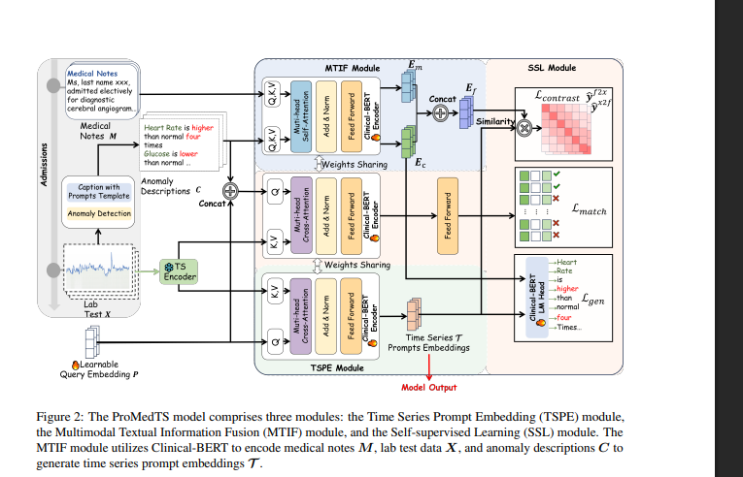
Notes:
Time series anomaly descriptions are generated using the IQR method (Vinutha et al., 2018) to identify anomalies, capturing their timing and polarity (above or below standard values) and describi
P acts as a connector between C (text) and T (time-series).
In training, the model learns how P should adapt so that time-series information blends smoothly into the LLM input space

Slide 10
Self-Supervised Learning (SSL)
Aligns the outputs from the above two modules (MTIF and TSPE).
Uses three self-supervised losses: contrastive, matching, generation.
Loss | What it does | Why it matters
Lcontrast | Makes embeddings of matching text–time-series pairs close together | Forces alignment
Lmatch | Matches prompt tokens between modalities | Strengthens fusion
Lgen | Generates pseudo-notes from time-series prompts | Enables generative understanding
Notes:
Cross-Modal Contrastive Alignment (Lcontrast) ->
Brings embeddings closer if text & labs are from the same patient.
Pushes apart mismatched pairs.
Teaches model to connect high-level language meaning with overall lab patterns (coarse-grained alignment).
Intra-Modal Matching (Lmatch)-> How it works
Treats this as a binary classification problem:
“Does this anomaly text describe this lab trend?”
Uses Clinical-BERT with cross-attention:
WHY-> Captures fine-grained temporal details.
Makes sure each anomaly caption truly reflects its own time-series, not just random similarity.
Strengthens the intra-modality consistency — internal coherence of the same data type.
Anomaly Description Reconstruction (Lgen)-> This loss trains the model to generate the anomaly description (text) from the time-series embedding.
Think of it as:
“Can the model write back the caption if it only sees the lab data?”
WHY->Ensures time-series prompts encode semantic meaning (“creatinine increased”) and temporal behavior (rise/fall patterns).
Brings language and numeric data into a shared latent space.
Improves interpretability — we can generate explanations.
Together, they ensure that time-series and text representations live in the same semantic space — so the model can think and reason across modalities.

Slide 11
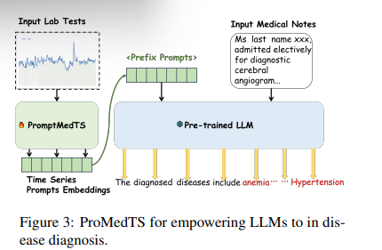
LLM-based Disease Diagnosis with ProMedTS
A fully connected layer aligns these embeddings with the LLM input space.
Lab prompts act as soft prefix prompts before clinical text.
The LLM processes both text + lab signals together for better prediction.
Enables unified reasoning across modalities → improved accuracy.
Notes:
The numeric lab results are first passed through the Time-Series Prompt Embedding module, which converts them into vector prompts that the LLM can understand.
A small tunable layer aligns the dimensions so they fit smoothly with the LLM input.
These prompt embeddings are then attached in front of the medical notes — like adding an extra prefix to the LLM’s text input.
The model is then fine-tuned to process both modalities together, meaning it reads the patient’s lab trends and their doctor’s notes at the same time.
This helps the LLM make more accurate and context-aware disease predictions.

Slide 12
Datasets Used
Dataset | Period | Type | Size | Key Data Used
MIMIC-III | 2001–2012 | ICU EHR | ~27,000 patients | Medical discharge summaries & lab test results
MIMIC-IV | 2008–2019 | ICU EHR | ~29,000 patients | Discharge summaries & lab test results
Notes:
a publicly available EHR dataset containing deidentified patients who were admitted to ICUs be-
It includes medical discharge summaries, lab test results, chest x-ray images and more. Our analysis focuses on EHR data from approximately 27,000 patients, including complete medical discharge summaries and lab test results. Our study targets 25 disease phenotypes as defined in the MIMIC-III benchmark (Harutyunyan et al., 2019a).
Data splitting follows the guidelines (Harutyunyan et al., 2019b) using a 4:1 ratio for training and testing

Slide 13
Dataset File | Period | Type | Key Data Used
patient_information.csv | 2017–2022 | Structured EHR | Patient demographics, surgery type, ASA status, discharge disposition
patient_history.csv | 2017–2022 | Structured EHR | Past medical history, comorbidities, previous procedures
patient_procedure_events.csv | 2017–2022 | Structured EHR | Procedure start/end times, surgical events, anesthesia details
patient_medications.csv | 2017–2022 | Structured EHR | Administered medications, doses, timestamps
patient_labs.csv | 2017–2022 | Structured EHR | Lab test names, results, reference ranges, timestamps
patient_post_op_complications.csv | 2017–2022 | Structured EHR | Postoperative complication outcomes for prediction

Slide 14
Experimental setup
Compared with models like GRU, PatchTST, LLaMA, and EHR-KnowGen.
Evaluated using Micro-F1 and Macro-F1 on MIMIC-III and IV datasets.
Used Flan-T5 as LLM backbone for fairness.
Notes:
For the disease diagnosis task, we adopt two scales of FlanT5 (Chung et al., 2024), OPT-0.1B, and QWEN2.5-0.5B as the frozen LLM to validate our model’s effectiveness. To ensure a fair comparison, all baselines also employ Flan-T5-small as their backbone.

Slide 15
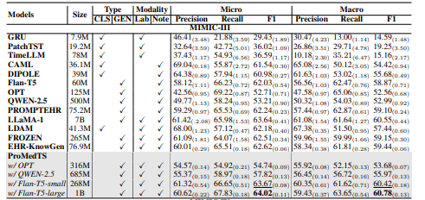
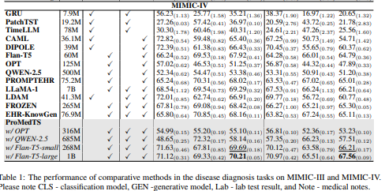
Experimental results
Evaluated on MIMIC-III and MIMIC-IV datasets.
Outperformed baseline models like GRU, PatchTST, and LLaMA.
Achieved highest Macro and Micro F1-scores.
Demonstrated efficiency with fewer parameters.
Notes:
Table 1 shows the evaluation performance of disease diagnosis for our model ProMedTS with all baselines -> 4.3
Multimodal models (e.g., EHR-KnowGen, LLaMA) exceed single-modality baselines (e.g., TimeLLM, PROMPTEHR), confirming the benefits of integrating text and time series
“ProMedTS achieves the best micro- and macro-F1 on both datasets, improving by nearly 5–8 points over prior multimodal methods. This confirms that self-supervised prompt fusion effectively captures relationships between medical text and time-series lab data.”
4.6 Prompt Length Sensitivity
Tested different prompt lengths (12, 24, 36).
Found 24 is optimal — balanced accuracy and computation
->Sensitivity Analysis of Time Series Prompt Length , Evaluating the Role of Anomaly Descriptions,

Slide 16

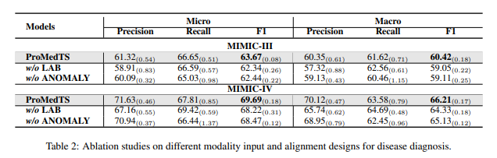
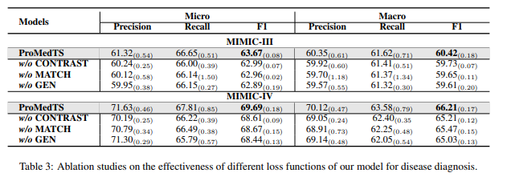
Ablation studies
Enhancing your presentation
To understand the contribution of each module in the ProMedTS framework.
To test what happens when certain features are removed or modified.

Slide 17
Limitations
Limited Evaluation Scope
High-Level Disease Focus
Lack of Explainability
  Computational Cost & Data Volume
  Anomaly Caption Bias
  Limited Clinical Validation
Notes:
Chain-of-Thought rationale (Wei et al., 2022) via knowledge distillation ->EXPLAINABILITY OF DISEASE PREDICTION
Lack of Explainability
The model focuses on aligning data modalities but does not explain its predictions (e.g., how or why it diagnosed a disease).
Clinicians need interpretability to trust AI systems. Without it, clinical adoption is limited.
High-Level Disease Focus
ProMedTS predicts broad disease phenotypes (like “heart disease”) rather than specific clinical events.
It’s too general for practical hospital tasks like predicting postoperative complications, sepsis, etc.
Limited Evaluation Scope
It was only tested on two datasets (MIMIC-III & MIMIC-IV) — both ICU-based EHRs, not other hospital or surgical data.
Limits generalization to other settings or patient populations.
Waveform Data Exclusion
ProMedTS only handled structured labs and notes — real EHRs like MOVER also include continuous physiological waveforms (vital signs, ECG). Ignoring these loses fine-grained temporal info.
You plan to start without waveforms due to size constraints but integrate them later — that’s part of your design.
Computational Cost & Data Volume
The method relies on Clinical-BERT, PatchTST, and large LLMs — making it computationally heavy. MOVER is larger than MIMIC-IV, so scaling can be challenging.
Use lighter models or modular training (e.g., freezing LLM weights, using prompt tuning only).
Anomaly Caption Bias
The anomaly descriptions are generated using rule-based templates, not medically verified text — possible semantic bias or oversimplification.
Consider validating anomaly captions with domain experts or refining the caption templates.
Limited Clinical Validation
The paper evaluated metrics like F1, but no clinician-in-the-loop validation was done to confirm medical usefulness.
You could incorporate explainability tools (attention or SHAP) to improve trust and interpretability.
Static EHR Segments
The model doesn’t account for temporal evolution of EHR data over hospital stays (it treats notes + labs as static).
You might experiment with dynamic temporal encoding or chronological prompts.
Overfitting to Specific LLMs
It used frozen LLMs like Flan-T5, OPT, Qwen — might not generalize to others or newer ones.
Future work could benchmark with medical LLMs (e.g., Med-PaLM, BioGPT).

Slide 18
Conclusion
  ProMedTS bridges text and time-series through prompt-guided multimodal learning.
  Achieves state-of-the-art results on MIMIC datasets.
  Limitations include lack of explainability and specific clinical focus.
Notes:
Figure 4 illustrates the parameter counts and computation times of baseline models on the two datasets. Our model, ProMedTS, matches the parameter counts and computation times of multimodal baselines such as LDAM and FROZEN, while using 25× fewer parameters and requiring one-third less training time than LLaMA, all while achieving superior diagnostic performance, highlighting its efficiency and effectiveness in languagetime series multimodal alignment and fusion.
In future work, we plan to extend our approach to apply to larger and more diverse datasets, such as Time-MMD (Liu et al., 2024), conduct experiments with different clinical tasks, explore additional LLM architectures, and investigate further improvements in modality alignment techniques.

Slide 19
References
Harsha Nori, Nicholas King, Scott Mayer McKinney, Dean Carignan, and Eric Horvitz. 2023. Capabilities of gpt-4 on medical challenge problems. arXiv preprint arXiv:2303.13375.
Jieneng Chen, Yongyi Lu, Qihang Yu, Xiangde Luo, Ehsan Adeli, Yan Wang, Le Lu, Alan L Yuille, and Yuyin Zhou. 2021. Transunet: Transformers make strong encoders for medical image segmentation. arXiv preprint arXiv:2102.04306.
Karan Singhal, Shekoofeh Azizi, Tao Tu, S Sara Mahdavi, Jason Wei, Hyung Won Chung, Nathan Scales, Ajay Tanwani, Heather Cole-Lewis, Stephen Pfohl, et al. 2023. Large language models encode clinical knowledge. Nature, 620(7972):172–180.
HP Vinutha, B Poornima, and BM Sagar. 2018. Detection of outliers using interquartile range technique from intrusion dataset. In Information and Decision Sciences: Proceedings of the 6th International Conference on FICTA, pages 511–518. Springer.

Slide 20

Thank you

Slide 21
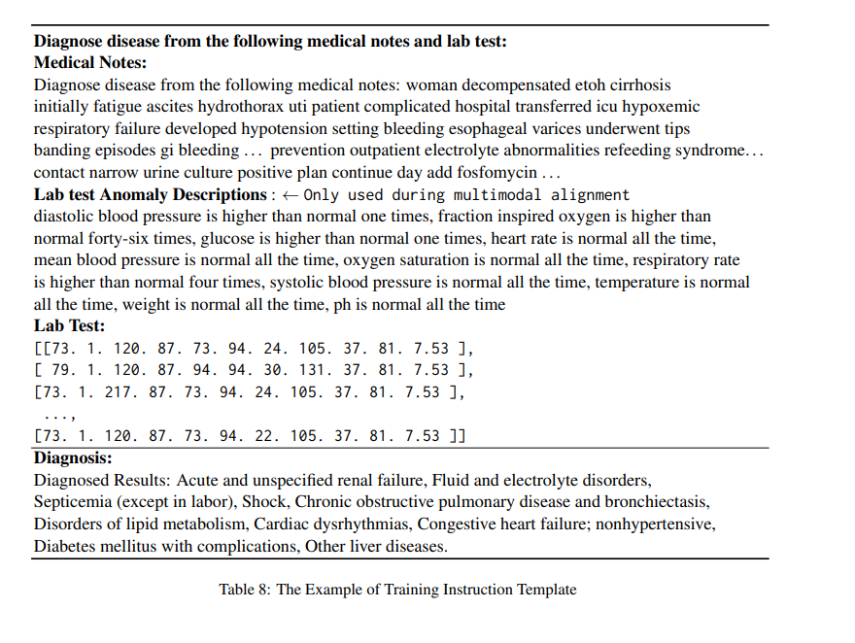

Slide 22
How were anomaly-caption templates chosen and validated clinically?
Which components are most sensitive to hyperparameters (α,β,γ)?
How were prompt init tokens constructed — random or BERT-initialized?
Any unpublished negative results (failures/timeouts)?
Plans for waveform integration and clinician evaluations? -> QUESTIONS

